Slide 1
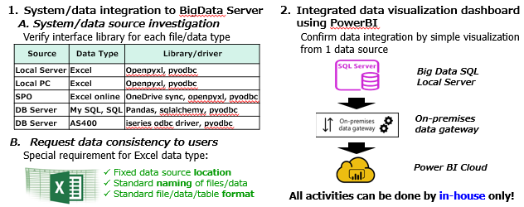
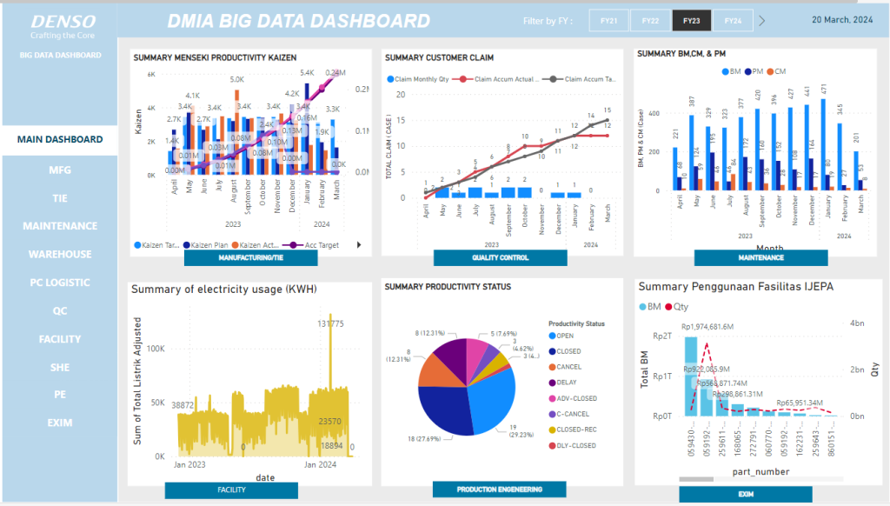
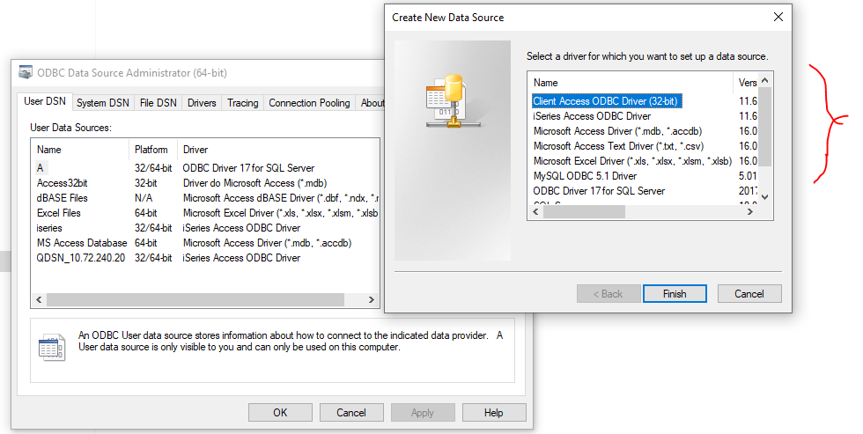
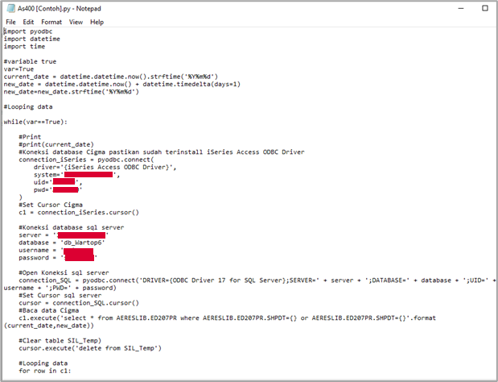
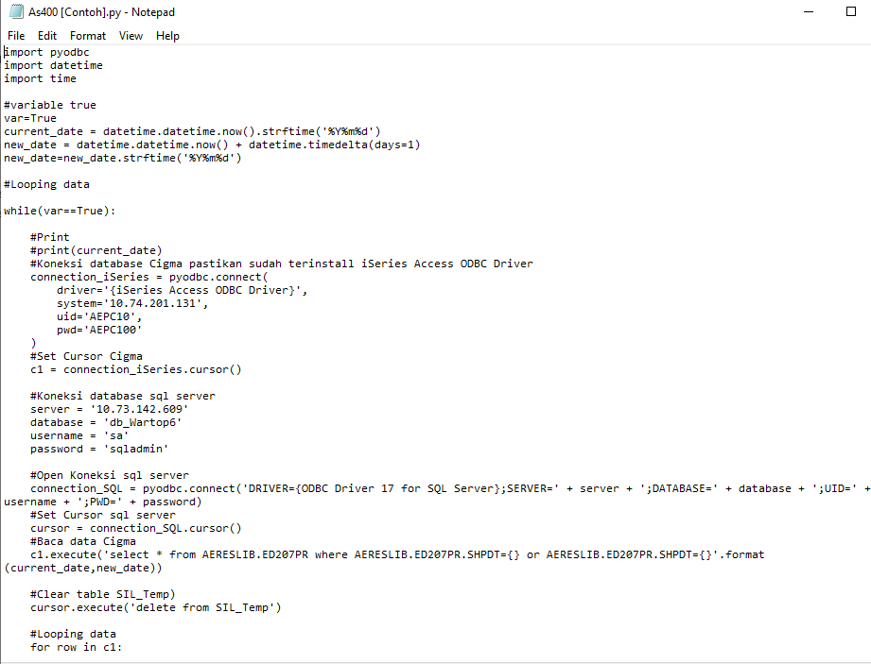
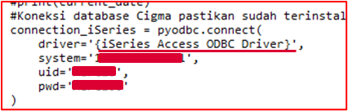
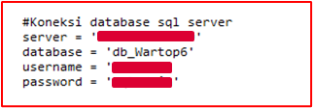
Overview implementation in DMIA
Data connection from any sources
Centralize to one “BigData” server
Data visualization or any other systems
Import Pyodbc driver to use various all available ODBC
Open connection to AS400 server
Simple change data capture by updated label
Source | Data Type | Update label
Local Server | Excel | Modified time @ folder
Local PC | Excel | Modified time @ folder
SPO | Excel online | Modified time @ SPO
DB Server | My SQL, SQL | Last update time @ log
DB Server | AS400 | Last update date @ table
Open connection to bigdata server

Slide 2
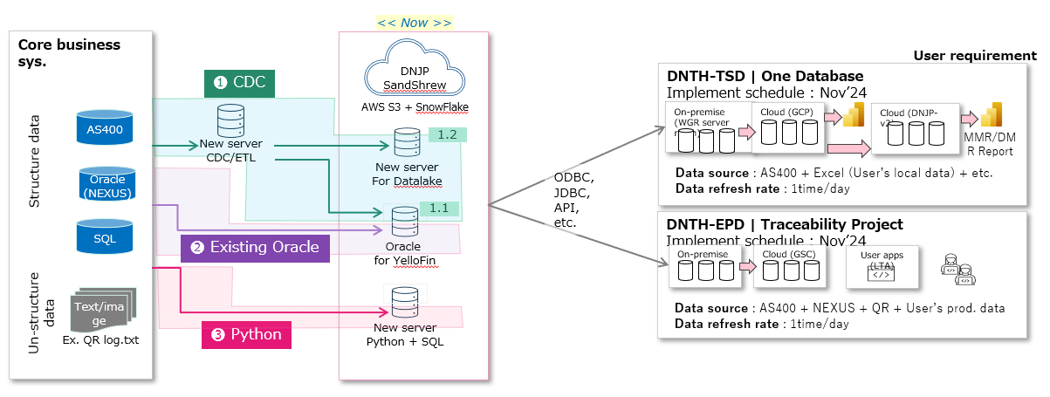
Proposed approaches for Asia Datalake connection
CDC and ETL function
BigData server
Option 1
All Python
(Pyodbc, Debezium, etc)
Merit: focus in one language, easier to maintain
Demerit: Need to program all
Option 1
Any SQL server
Merit: Most familiar DB
Demerit: License cost for large scale usage
Option 2
Logstash + Python
Merit: Special tool for CDC with better performance
Demerit: Need to learn/upskill several program languages
Option 2
SQL + NoSQL server
Merit: Reduce cost in NoSQL DB by Logstash
Demerit: Need to learn/upskill for NoSQL
Propose Option 1 or 2 with upskill of IS member to face future challenge of DX total solutions by internal
(Yes/No to investigate?)

Slide 3
Next detailing
Items to be investigated and evaluated:
-Impact to the data source and network
-DB server requirement (ram/cpu/DB)
-DMIA or other GC IS can support to implement or not? PM service provide?
-Implementation service and cost (initial setup/operation support after implement)
-Lead-time of implementation
Will invite related GC IS to discuss.
First conclusion target by Fri 11/15

Slide 5
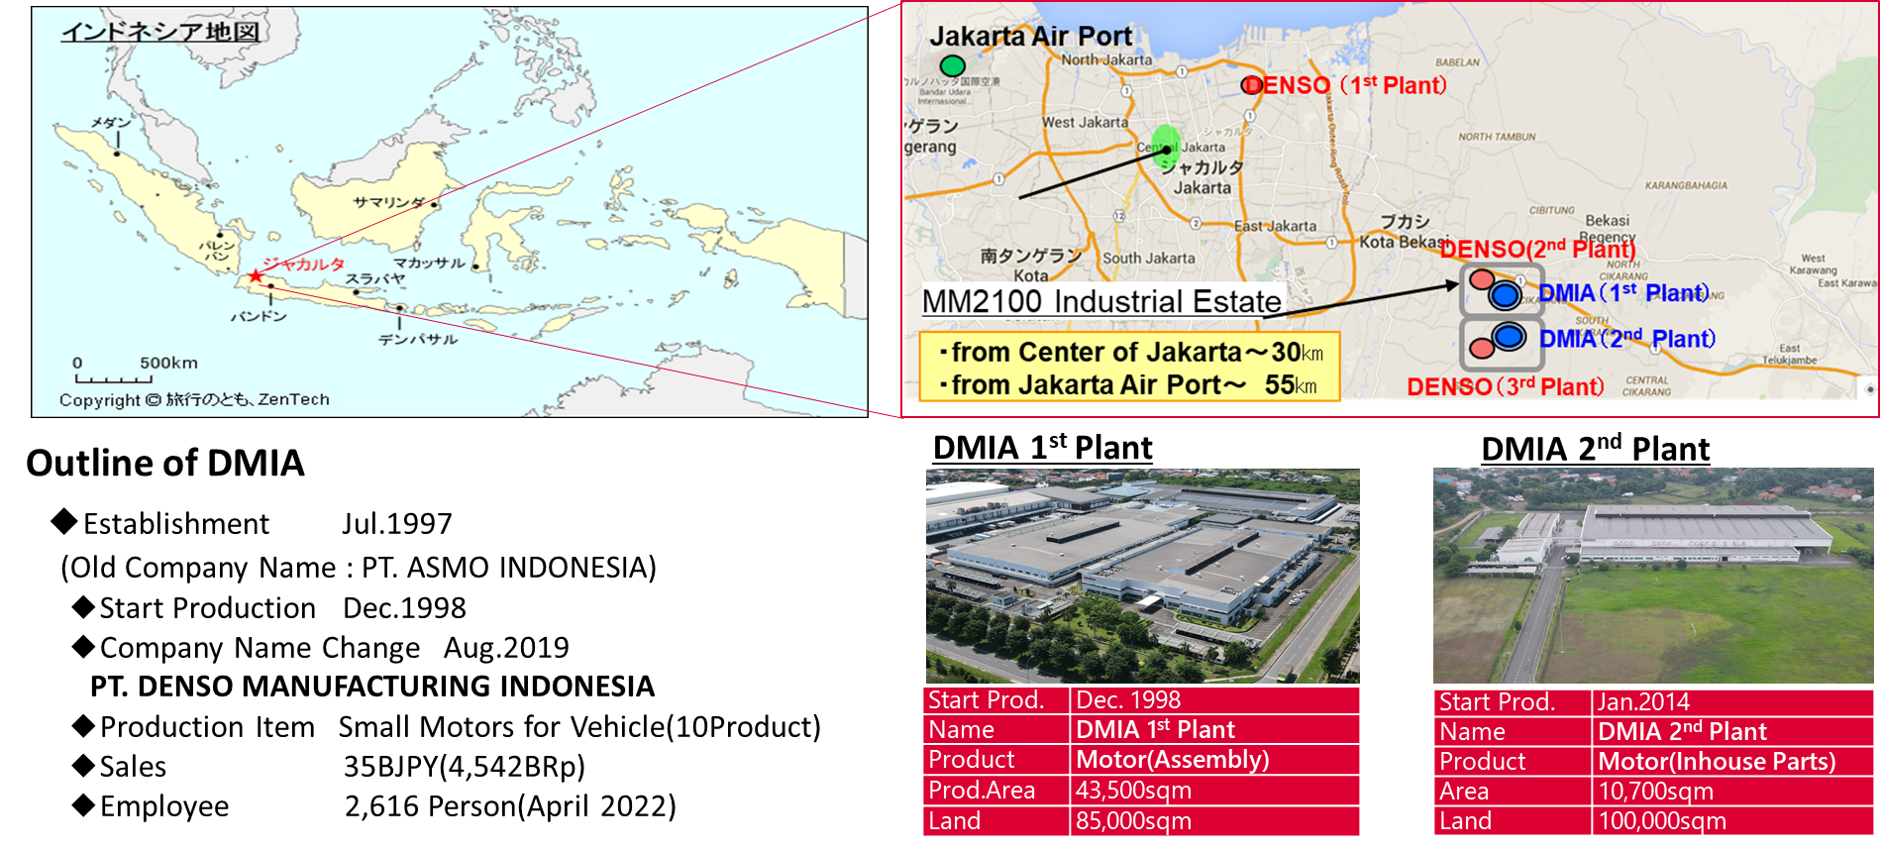

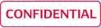
34th AIPIC Meeting
Simple Big Data Acquisition and Visualization
~A Technical Insight~
PT. Denso Manufacturing Indonesia
March 21, 2024
Notes:
Good Morning everyone, we are from DMIA
We would like to explain our project about cooper wire integrated handling using WOOST k23

Slide 6
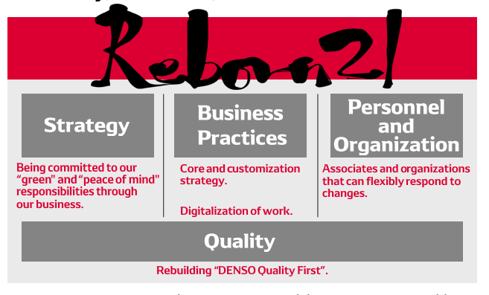
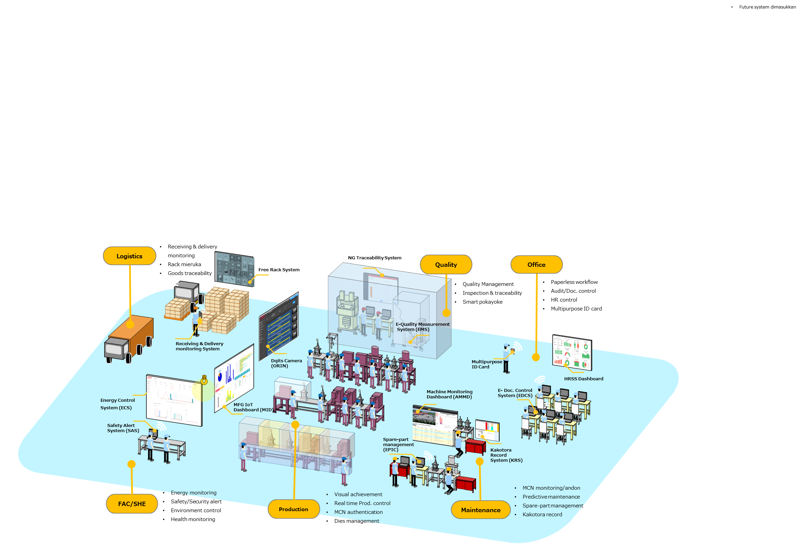
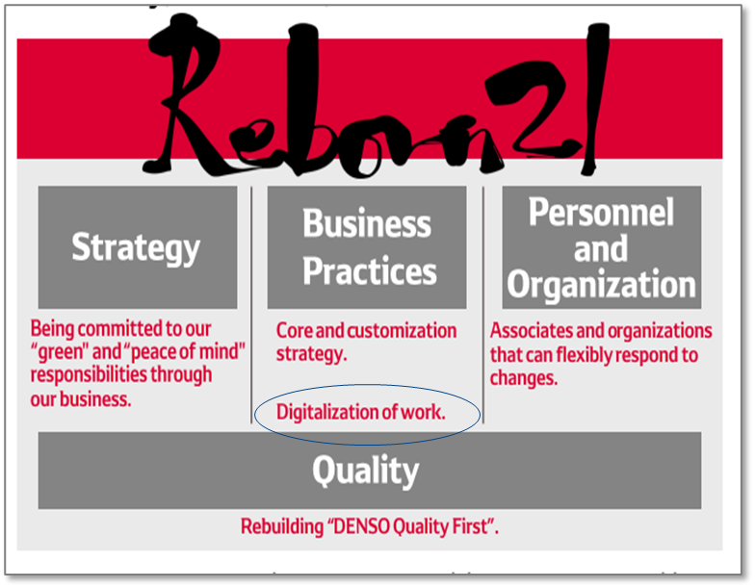
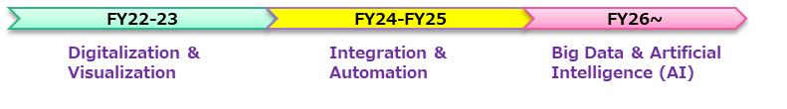
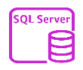

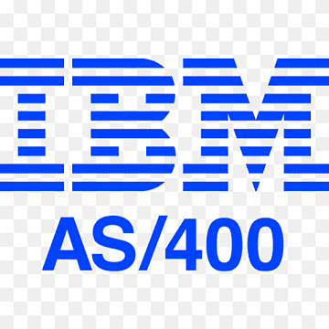

1. Background
DMIA DX future image and roadmap
Future image
SMART Manufacturing Company 2026
Business Practices
Personnel & Organization
LOGISTICS
NG TRACEABILITY SYSTEM
QUALITY
OFFICE
Free Rack System
QUALITY MANAGEMENT
PAPERLESS WORKFLOW AND DOC CONTROL
Receiving & Delivery Monitoring System
Dqits Camera (ORIN)
Multipurpose ID Card
Energy Control System (ECS)
Machine Monitoring Dashboard (AMMD)
E-Doc Control System (EDCS)
HRSS Dashboard
Safety Alert System (SAS)
MFG IoT Dashboard (MID)
Spare-part Management (EPIC)
Digitalization of Work
SHE MONITORING
Kakotora Record System (KKS)
FAC/SHE
PRODUCTION
REAL TIME PRODUCTION CONTROL
MAINTENANCE
MAINTENANCE MONITORING
Improve business process by digital integrated system throughout the company
DX Roadmap
Digitalization & Visualization
Integration & Automation
Big Data & Artificial Intelligence ^{(AI)}
Current progress
Next challenge
Already start digitalization in each Dept
Make system/data integration of all Dept
Digital Data
already available
Web/SQL
A Dept System/Data
D Dept System/Data
Microsoft cloud
B Dept System/Data
complex system/data interfaces
E Dept System/Data
Visualization
in each system
AS400
Excel, etc
C Dept System/Data
F Dept System/Data
Variety of system and data platforms according to user needs
Need many different type of interfaces to integrate all systems
Lead to big additional cost!
Our Mission: Improve Operation And Management Workstyle By Low-Cost DX
Notes:
Our DX strategy low-cost development by in-house (internal Denso),we prepare talents through Citizen developer and DX KOSEN student.
Which our mission is improve operation and management workstyle by low-cost DX.

Slide 7

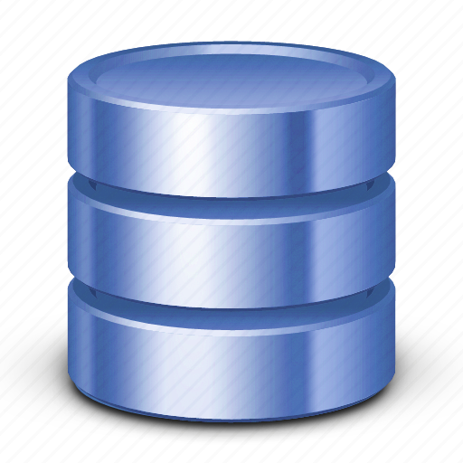
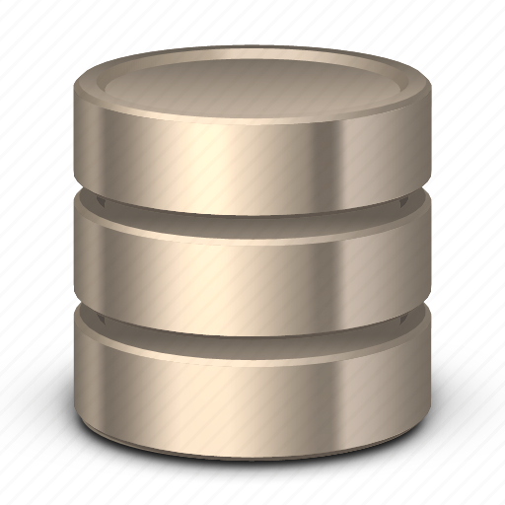
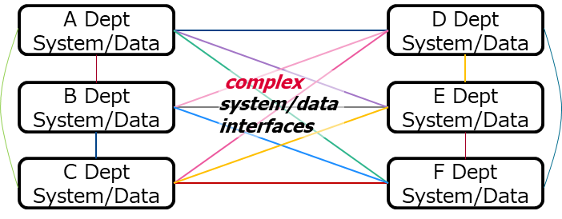



2. Issue & Strategy
Main issues of interface between 2 different system/data platforms
Aspect | Common approach | Issue
Interface availability
Interface complexity
interface to other system/data platform not provided by default
must ask programmer to make interface
- in-house programmer not familiar/lack of knowledge
- need vendor support for core system related → high cost
?
?
System A
System B
DENSO
?
?
Example:
JDE interface ~USD3000
No interface by default
interface directly connects 2 system/data platforms
must make many interfaces for all connection among systems/data platforms
- Too many interfaces
- Too complex relations
Take time/cost to make, difficult to maintain (update, change, etc)
Our strategy
1. Simple topology
2. Easy DX tool to make data interface by in-house
Avoid complex direct interfaces by setting 1 BigData server that can work as intermediary
Select the best tool that suitable for Citizen Developer
15 interfaces
6 interfaces
Concern | VBA Macro | PowerAutomate |  | UiPath | Python
 |  | Web | Desktop
Multi-platform (windows, linux, android, server) | X | △ | 〇 | 〇 | ◎
Automation | △ | △ | 〇 | ◎ | △
Interface Library | △ | △ | △ | 〇 | ◎
License | No | Yes | Yes | Yes | No
Judgement | X | △ | △ | △ | O
A Dept System/Data
BigData Server
D Dept System/Data
B Dept System/Data
E Dept System/Data
C Dept System/Data
F Dept System/Data
Can reduce more than 50% of interfaces
Integrated DASHBOARD
Bonus!
Python is the best to make multiple interfaces
Notes:
Our DX strategy low-cost development by in-house (internal Denso),we prepare talents through Citizen developer and DX KOSEN student.
Which our mission is improve operation and management workstyle by low-cost DX.

Slide 8
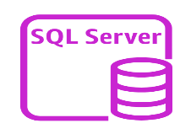

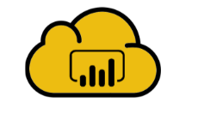
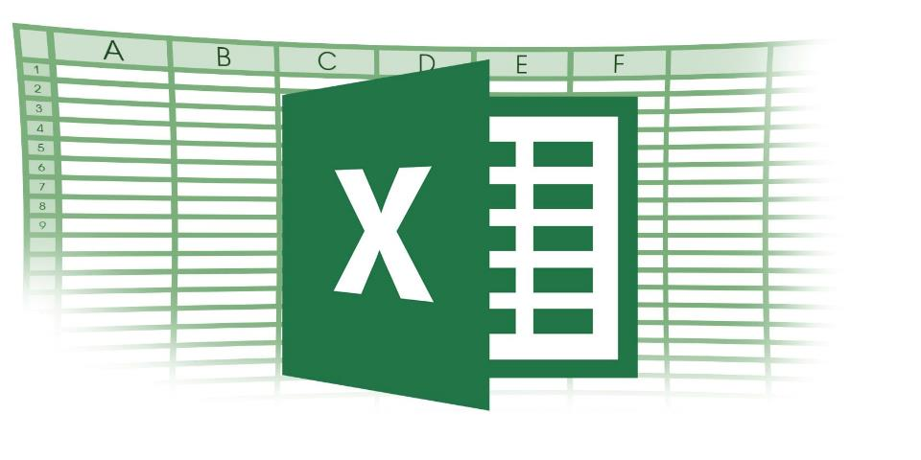




3. Activity & Result
Activity
System/data integration to BigData Server
Integrated data visualization dashboard using PowerBI
A. System/data source investigation
Verify interface library for each file/data type
Confirm data integration by simple visualization from 1 data source
Source | Data Type | Library/driver
Local Server | Excel | Openpyxl, pyodbc
Local PC | Excel | Openpyxl, pyodbc
SPO | Excel online | OneDrive sync, openpyxl, pyodbc
DB Server | My SQL, SQL | Pandas, sqlalchemy, pyodbc
DB Server | AS400 | iseries odbc driver, pyodbc
Big Data SQL
Local Server
On-premises data gateway
Request data consistency to users
Special requirement for Excel data type:
Fixed data source location
Standard naming of files/data
Standard file/data/table format
Power BI Cloud
All activities can be done by in-house only!
Schedule
Result
Focus on KPI data in Genba (MFG, PE, FAC, QC, PC, WH, etc) as pilot project
DMIA 1st Integrated BigData Dashboard
Activity | PIC | Nov/W4 | Dec/W1 | W2 | W3 | W4
Planning | SD/IT
DX tool testing | Team A
Data source survey in Genba | Team B
Data interface | Team A & B
PowerBI view
Full-custom!!
Totally FREE!!
Finish in 1 month by our young talents!
Notes:
Our DX strategy low-cost development by in-house (internal Denso),we prepare talents through Citizen developer and DX KOSEN student.
Which our mission is improve operation and management workstyle by low-cost DX.

Slide 9
4. Next Plan & Recommendation
Next plan (~April’24)
Utilize system/data interfaces function for low-cost Production Traceability System
Traceability System
BigData Server
Receiving
Part Stock
Quality Control
Manufacturing
FG Stock
Delivery
Recommendation
Propose PYTHON programming language as one of RIPI tools and learned by Citizen Developer
Benefit:
Famous free and open source programming language with strong global community
Enormous number of free library including AI/Machine learning related function
Program source code with single function (ex: system interface, data modeling, etc) can be less than 100 lines (still simple!)
Let’s make successful DX activity with the best selection of RIPI tools
Notes:
Our DX strategy low-cost development by in-house (internal Denso),we prepare talents through Citizen developer and DX KOSEN student.
Which our mission is improve operation and management workstyle by low-cost DX.

